Slide 1
Build Local Environment VirtualBox, Kali, Metasplitable 2, OWASPBWA

Slide 2
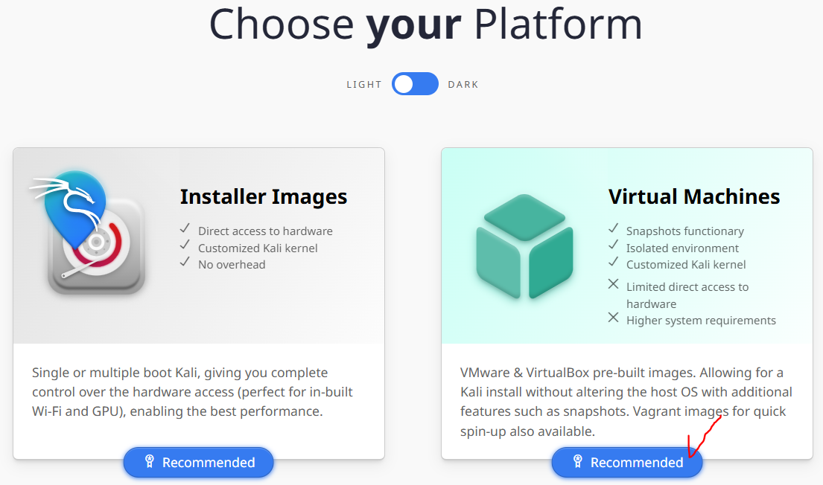
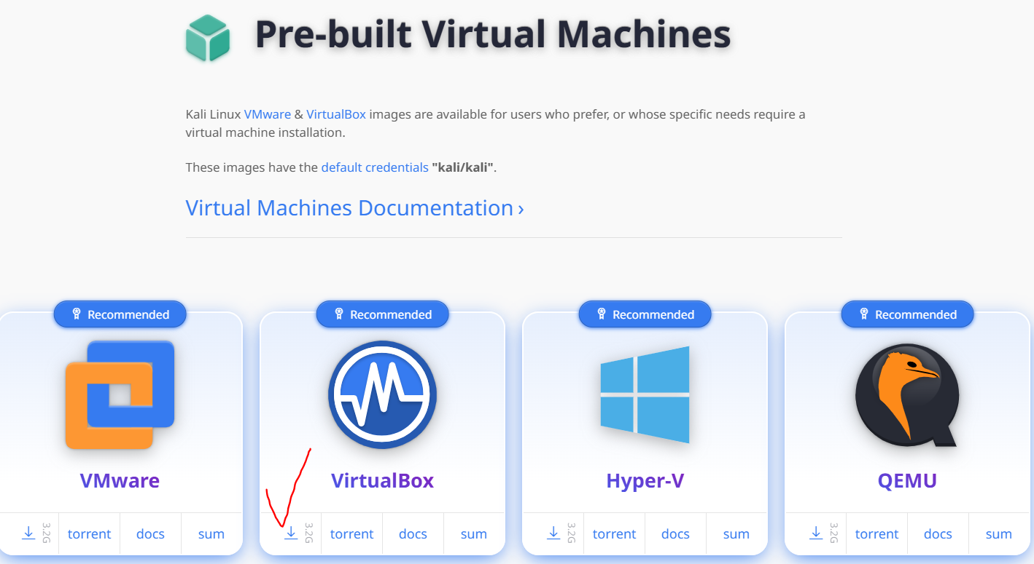
Kali
Download link: https://www.kali.org/get-kali/#kali-platforms
Double click, finish setup
Default account&password: kali/kali

Slide 3
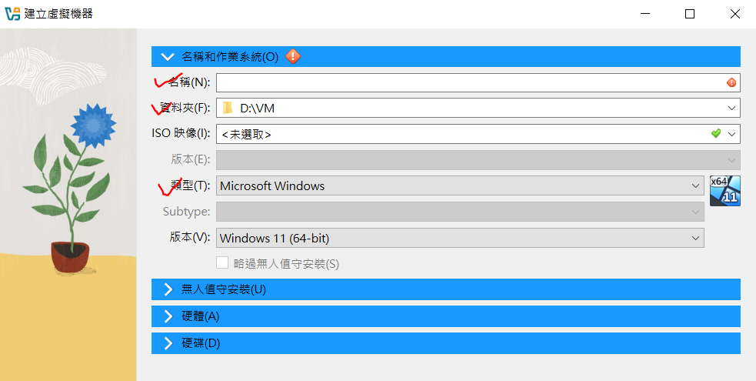
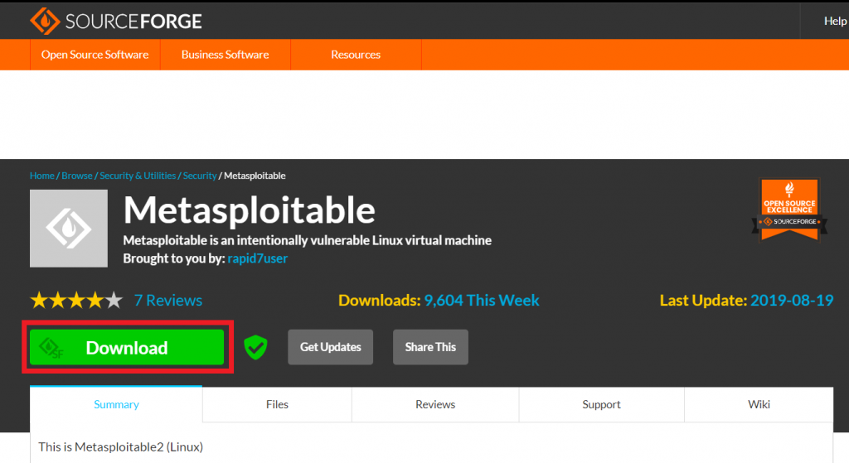
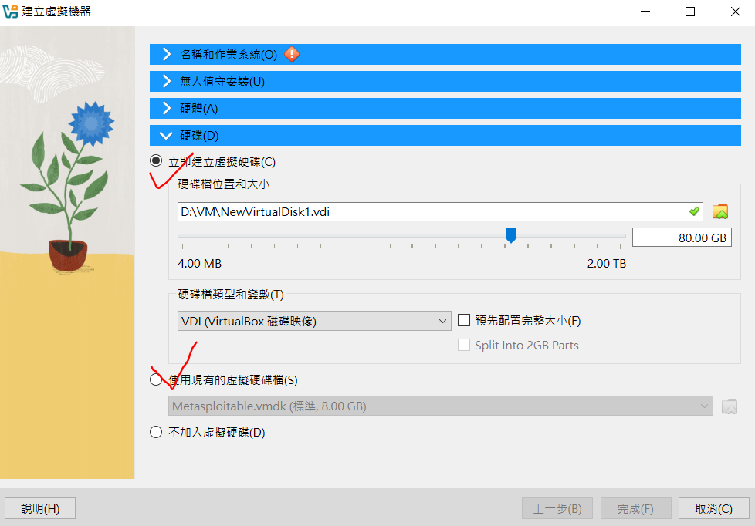

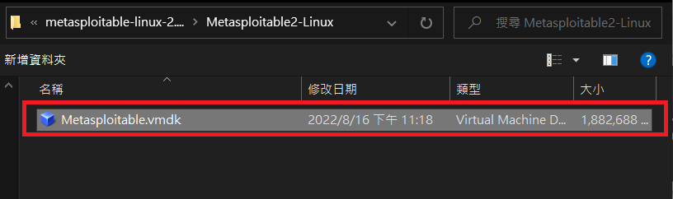
Metasploitable2
Default account&password: msfadmin/msfadmin
Download link: https://sourceforge.net/projects/metasploitable/
Extract zip file
Reference: https://ithelp.ithome.com.tw/articles/10299666

Slide 4
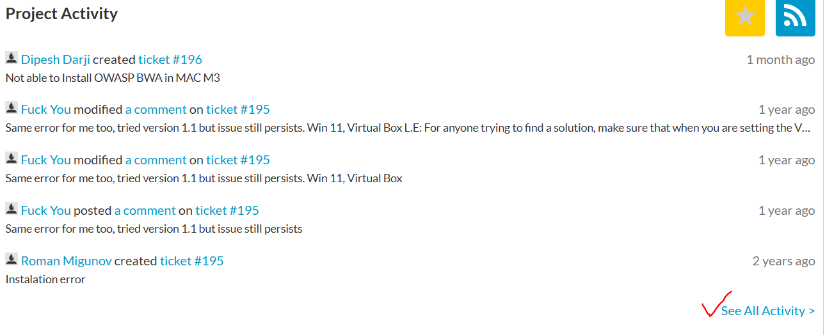
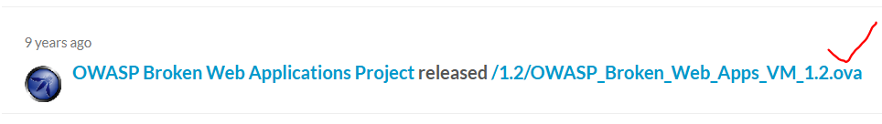
OWASPBWA
Download link: https://sourceforge.net/projects/owaspbwa/
Double click, finish setup
Default account&password: root/owaspbwa
Reference: https://ithelp.ithome.com.tw/articles/10299666

Slide 5
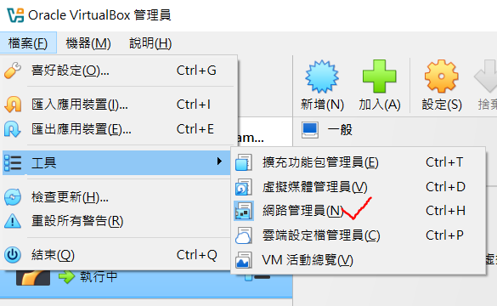
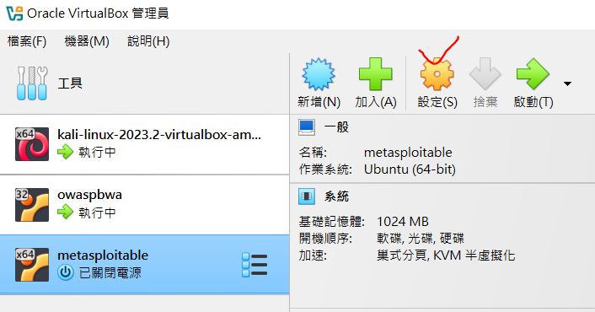
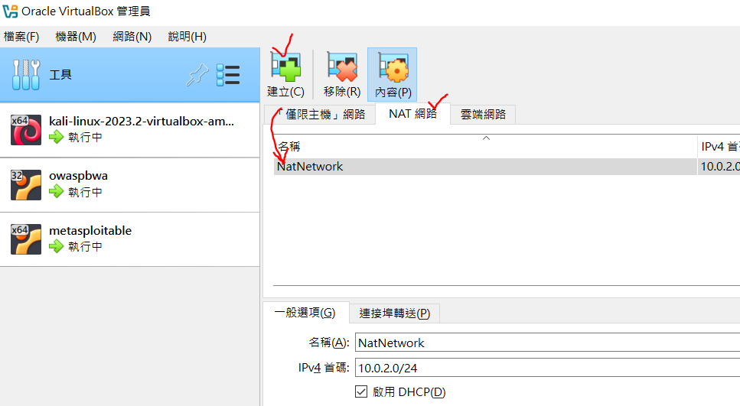
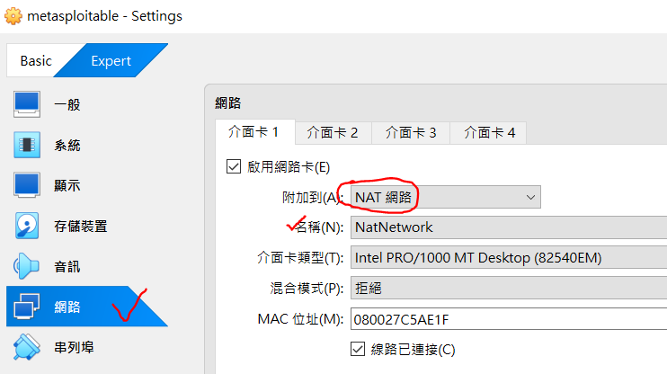
Set Up Network
Do the same operation to each machine

Slide 6
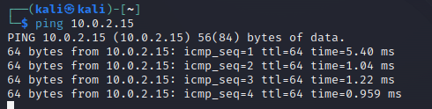
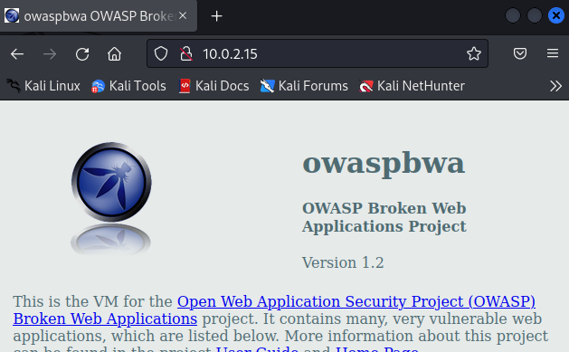
Check Network
Check IP: Open terminal and enter `ifconfig | grep inet`
Make sure 3 machines have their own IP and under the same network. I.E., Kali is 10.0.2.4 and OWASPBWA is 10.0.2.15
In Kali, ping OWASPBWA and should see something like below:
In Kali, open browser and enter url: “http://<ip of metasploitabl2>”, should see

